Slide 1
CS542 – Database management Systems
Introduction
Professor: Rodica Neamtu
rneamtu@wpi.edu

Slide 2
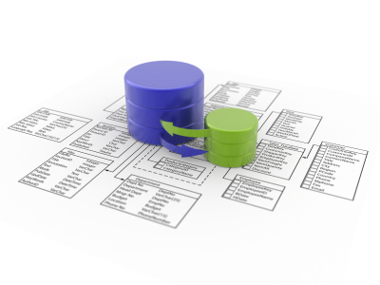
What is a Database System?
Software platform for managing large amounts of data
Managing means:
Storing, querying, indexing,
and structuring the data
Different names refer to the same thing:
Database systems
Database management systems
DBMS

Slide 3
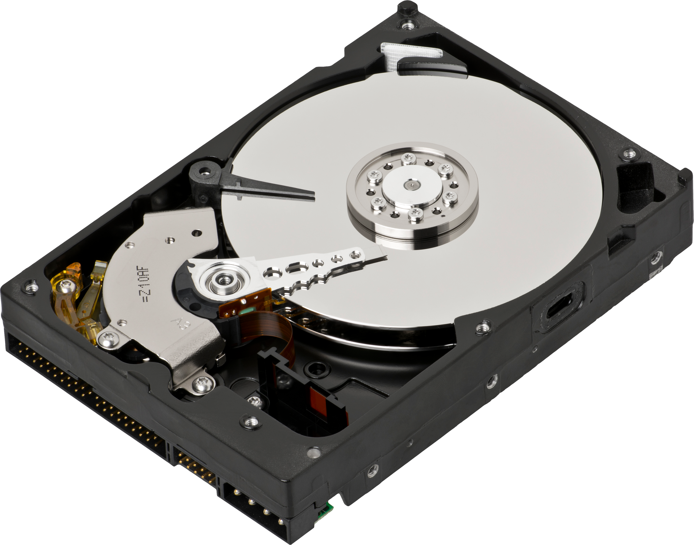
What is a Database System? (Cont’d)
Data is too large to fit in memory
Data stored on disk
Data is persistent
Many users access the data and do so fast

Slide 4
Database Applications
Have you ever used a database application?
E-commerce: books, equipment etc. at Amazon
Banks -- your valuable $$ and ATM transactions
Airlines – manage flights to get you places
Universities – manage student enrollment
GIS (Maps) – find restaurants closest to WPI
Bio-informatics (genome data)
?
Data is everywhere. To efficiently manage it, we need DBMS

Slide 5
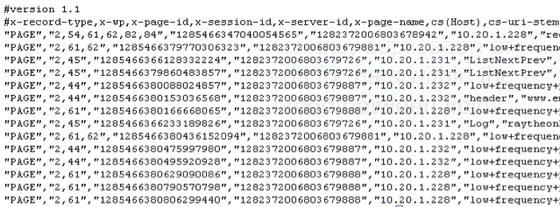


Why use DBMS, and not files?
Several drawbacks of using file systems
Data redundancy and inconsistency
Multiple file formats, duplication of information in different files
Multiple records formats within the same file
No order enforced between fields
Difficulty in accessing data
Need to write a new program to carry out for each new task
Integrity problems
….
Account balance >= 0
Student cannot take same course twice

Slide 6

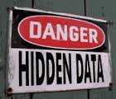
Why use DBMS, and not files? (Cont’d)
Concurrent access by multiple users
Many users need to access/update the data at the same time (concurrent access)
Security problems
Hard to provide user access to some, but not all, data
Recovery from crashes
While updating the data the system crashes
Maintenance problems
Hard to search for or update a field
Hard to add new fields

Slide 7
DBMS Provides Solutions
Data consistency even with multiple users
Efficient access to the data
Data integrity embedded in the DBMS
Recovery from crashes, security

Slide 8

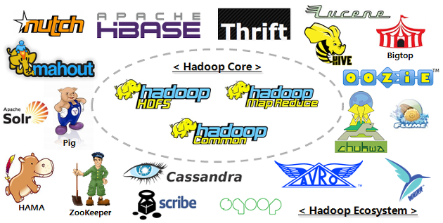


Scope of Data Management
Current Data: Complexity + Volume ➔ Big Data
Relational DBs
MapReduce & Hadoop
Data Stream Management Systems
Distributed DBs
NoSQL: NotOnly SQL

Slide 9





Where are RDBMS used ?
Backend for traditional “database” applications
Backend for large Websites
Backend for Web services
Airline reservation
University registration
Bank accounts and transactions
Movie Database
Hospital System

Slide 10
Access to DMBS
“Two tier database system”
Applications
Direct SQL
Connection
(ODBC, JDBC)
Database server (someone else’s C program)
Data files

Slide 11
Functionality of a DBMS
The programmer sees SQL, which has two components:
Data Definition Language - DDL
Data Manipulation Language – DML
Behind the scene the DBMS has:
Query Optimizer
Query Engine
Storage Management
Transaction Management (concurrency, recovery)
First part of the course
Second Part of the course

Slide 12
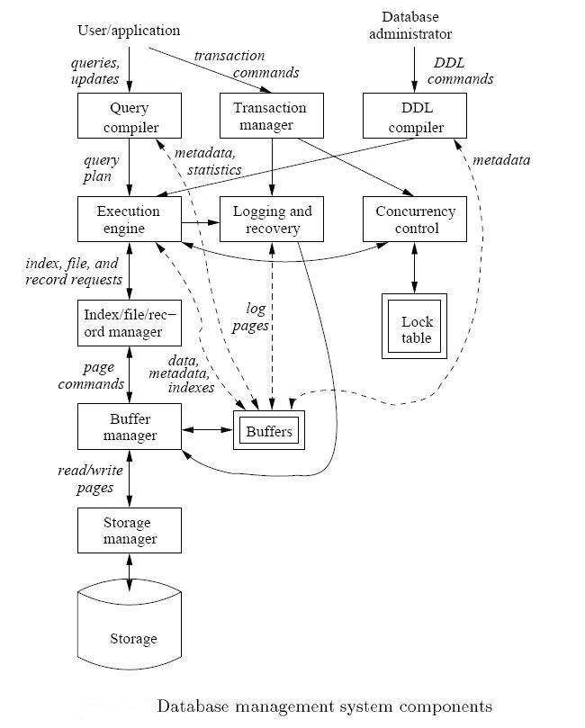
DBMS Backend Components

Slide 13
Basic Terminology
Data Model
Tools used for describing the data
Data Schema
Describes structures for a particular application, using the given model
Database
Collection of actual data that conforms to given schema
Database Management System (DBMS)
Software platform that allows us to create, stores, use, and maintain a database
SQL & Data Manipulation Language (DML)
Language to manipulate, e.g., update or query, the data

Slide 14
Data Model
A collection of tools for describing
Data objects
Data relationships
Data semantics
Data constraints
Several data models:
Relational model
Entity-Relationship (ER) data model
Object-based data models (Object-oriented)
Semi-structured data model (XML)
Other older models:
Network model
Hierarchical model
We will learn these two models

Slide 15
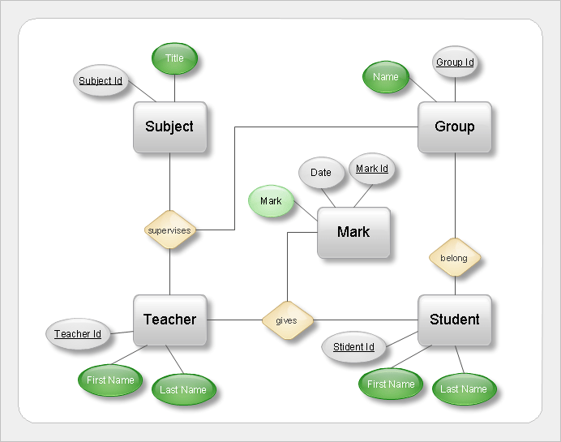
Example: ER Model
Graphical model for describing entities, attributes, and relationships

Slide 16
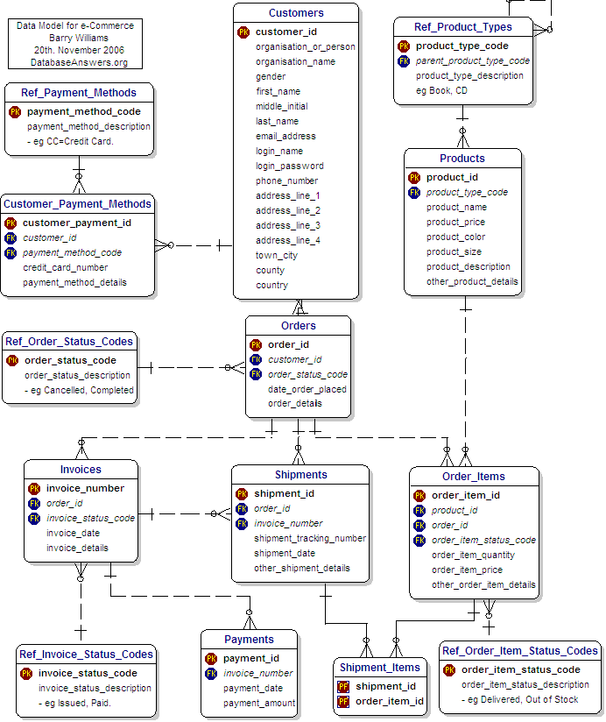
Data Schema
Captures the relationships between objects (“entities”) in an application
Schemas can be represented graphically or textual

Slide 17

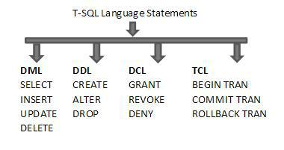
Query Language (SQL)
Language for accessing and manipulating the data organized by the appropriate data model
SQL: Structured Query Language
SELECT ID, Name
FROM Student
WHERE address=“320FL”;

Slide 18
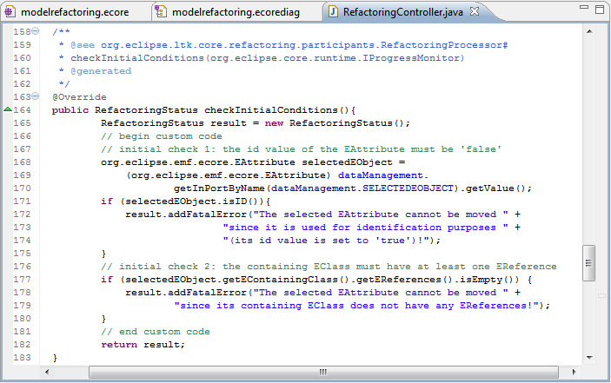
Query Language
Two classes of languages
Procedural – user specifies what data is required and
how to get the data
Declarative (non-procedural) – user specifies what data is required without specifying how to get the data
DBMSs use SQL ➔
SELECT ID, Name
FROM Student
WHERE address=“320FL”;

Slide 19
A Big Picture of What You will Learn

Slide 20

Logical vs. Physical
How is this information stored???

Slide 21
Levels of Abstraction
View Level --describes how users see the data
Logical Level – describes the logical structures used
Relational Model
ERD model
Physical Level -- describes files and indexes
Usually hidden from users

Slide 22
Levels of Abstraction: Airline Application Example
Logical (Conceptual) Level
Flight, Passenger, Travel tables
Physical Level
Flight table stored as a sorted file on the flight number
Index on flightNo attribute for Flight relation
View Level (External Schema)
NoOfPassengers (flightNo, date, numPassengers)
Hide employees salary
These levels of abstraction lead to
“Data Independence”

Slide 23
Data Independence
DBMS has the three levels of abstractions
Ability to modify one level without affecting the other levels
Physical data independence:
Physical schema such as indexes can change, but logical schema do not need to change
Protection from changes in physical structure of data
Logical data independence:
Logical schema can change, but views do not need to change
Protection from changes in logical structure of data

Slide 24


Who uses databases?
End users
DB application programmers
Database Administrators
Database design
Security, Authorization
Data availability, crash recovery
Database tuning (for performance)

Slide 25
Summary : Why study DBMS?
Need to process large amounts of data efficiently
Video, WWW, computer games, geographic information systems (GIS), genome data, digital libraries, etc.
Make use of all functionalities provided by DBMSs
DB administrators and programmers hold rewarding jobs
DB research is one of the most exciting areas in Computer Science !!

